Slide 1

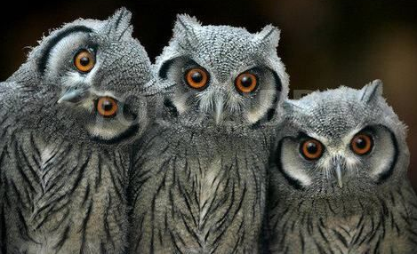


Network Traffic Packets Classified as Textual Images
for Intrusion Detection
Myriam Leggieri | @iammyr
#GHC
18
Notes:
hello everyone
i’d like to start by saying that
i absolutely admire each one of you. most of us in this room share similar troubles, obstacles and bias to overcome, coming from both outside and within our own minds. But we’re here today because we share a higher concern for the wellbeing of minorities, we share a common dream for better quality of life for all women, that goes beyond our own everyday’s lives. For this, I admire you all. You are my heroes: please, do reach out to me, at the end of the talk; i’d love to connect with you!
The topic of this talk is about proposing an improvement to the current industry standard solution for detecting malicious traffic even though the traffic is encrypted

Slide 2




Let’s Connect!
To Decrypt or not to?
Promising Results
The “Never Decrypt” Solution
PRESENTATION NAME / 2020 / SLIDE #
Notes:
I’m going to first share what is behind this project, its goal, technical details and finally, how could you start a similar project, yourself and improve it
All this, with the hope of connecting with you and inspiring you

Slide 3

Myriam Leggieri
Security Engineer
Design and Code Security Review
Development of Security Tools
Security Awareness
Pentesting
@iammyr
Notes:
My name is Myriam Leggieri and I’m a Security Engineer at Workday. Workday is a leading provider of enterprise cloud applications for finance and human resources. It delivers financial management, human capital management, and analytics applications designed for the world’s largest companies, educational institutions, and government agencies.
Given the sensitive nature of financial and hr data, it is particularly critical, for Workday, to secure its customers’ data.
Myself and my team, personally contribute to this goal, by performing pentesting and security reviews of code and design for all internal projects, as well as development of sec tools and of workshops and challenges to raise sec awareness among developers.
I love my job because I believe security is a way to help others, to help average citizens protecting themselves. And I believe this is increasingly important, as technology becomes more and more ubiquitous while companies try to push the boundaries of privacy as much as possible. But also, the process of imagining all possible ways attackers may break into a system, is a creative exercise that would never tire you down.
But before becoming a security engineer, I studied as a Software Developer and graduated with a PhD in sensor data mining. So I worked with machine learning in the past and after switching to security I saw an opportunity to apply that knowledge to solve one of the many challenges that security faces at the moment. Which is how the project I’m presenting today came to life.

Slide 4
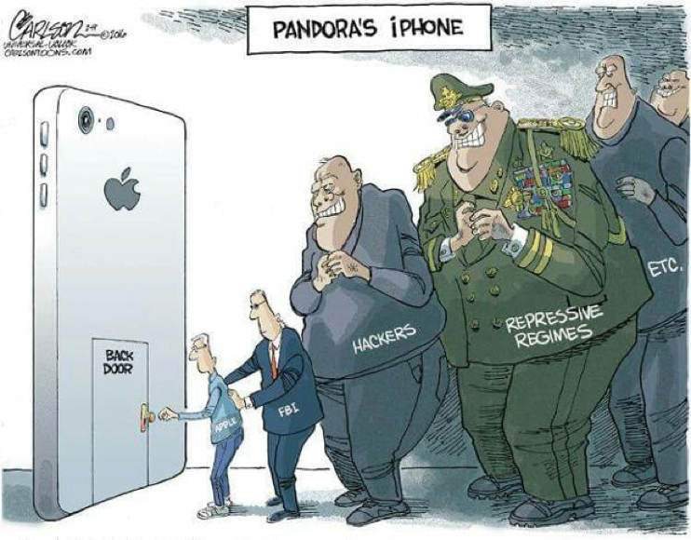
Encryption vs. Security
Notes:
Encryption is a powerful tool that end users have to ensure their own data is properly secured. However, there are several actors who would like to bypass encryption in order to look at the data in clear, for distinct reasons.
Corporations and Governments would like to do this with the purpose of detecting criminal activities,
Criminals would like to do it with the purpose of leaking data for a disparity of final goals but mostly moved by financial gain.
Among all these actors, governments stick out for their privileged position of power which they can use to force companies to insert a backdoor into their products which governmental agencies can use to access unencrypted data or they can force standard approval entities to approve as standard, encryption algorithms which governments have already found a way to bypass.
As a conclusion, while encryption is extremely valuable for end users as in, for all of us, it is constantly challenged and broken by all these people in the slide, for their own goal.

Slide 5
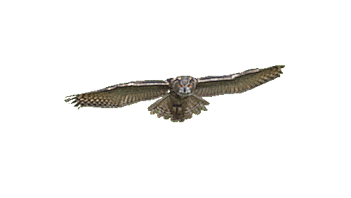



The Problem
Notes:
Currently, if you are a company in no power position who is generating encrypted content for its customers, then if you wanted to analyse it for detecting security issues, the only thing you can do is to terminate the encryption at some point, check the content, then encrypt it again and forward it to its final destination.
This is nowadays, the industry standard solution. The problem with this model though, is that there is a point in which the content gets decrypted. At that point, it becomes visible not only to the good people but to the bad ones as well. If attackers managed to compromise that machine or somehow access its content, they would be able to steal the unencrypted data.

Slide 6
Proposed Solution
Monitoring Encrypted Traffic
without Decrypting
Notes:
So I thought, what if there was other information attached to the network packets, which could allow us to detect malicious activity without even attempting to decrypt the packet payload itself!

Slide 7
Convolutional Neural Networks (CNN)
Long Short Term Memory Networks (LSTM)
Conditional Random Fields (CRF)
Notes:
How could we do that? Deep Learning techniques have proven successful in classifying patterns for a variety of objects. I chose CNN, LSTM and CRF and you may ask then...

Slide 8

Notes:
...why?

Slide 9




CNN → Learn Spatio-Temporal features
LSTM → Learn Long-Term Memories
CRF → Learn from Textual Metadata
Notes:
In this case, the objects to classify would be raw network packets (what’s called pcap) which - even when their payload is encrypted for instance because of the TLS protocol - still carry with them a lot of textual metadata which we could leverage like the source and destination, the timestamp, the size, etc. Network packets and the trajectory they follow across the network, can be depicted in a diagram. Just as much as you depict it in a diagram you can then build an RGB image representation of it and feed it into a deep learning image classifier such as Convolutional NN.
Then, given that stealth attacks involve packets across the network that are very much distant in time, we feed the result of the image classifier to the Long-Short-Term Memory NN, which is capable of finding correlations between objects that are very distant in time (which can be abbreviated as LSTM).
Finally, we take the LSTM output and feed it into the Conditional Random Fields algorithm which, given a series of textual data, is able to predict to which category it belongs, meaning malicious or “approved”, good to go.

Slide 10


Fuzzers
Analysis
Backdoors
DoS
Exploits
Generic
Reconnaissance
Shellcode
Worms
DataSet
100 GB
2.540.044 raw pcap traffic
175.341 training set
82.332 test set
Sets of 4 packets
49 features each
R - 4 x 1 time/space -related features
G - 3 x 37 src/dest, IP+Port -related features
B - 4 x 11 remaining features
0<px<255 → normalise input
The UNSW-NB15 data set by N. Moustafa, J. Slay (2016)
Time
Notes:
I used a public dataset made of 1million 5hundred pcap files, counting for around 100GB.
They are already labelled as belonging either to the class called “Generic” - meaning normal traffic - or to any of the other 8 classes that identify malicious packets as part of different types of attack, for instance involving worms or fuzzers or delivering shellcode, etc.
I consider each packet to represent an RGB image with 49 features each. Out of these,
- the R channel in RGB is given by the 4x1 vector of time and space -related features
- the G channel in RGB is given by the 3x37 matrix of features related to source, destination, IP and Port
- the B channel in RGB is given by the 4x11 matrix of all remaining features
In RGB images every pixel is an integer between 0 and 255. Therefore, I do first categorise the non-numeric features and then normalise all features so that they fall within this range.
Once the packets are transformed into images they are classified 3 times. First according to the image features, then according to their time-based correlations and finally based on their textual correlations.

Slide 11
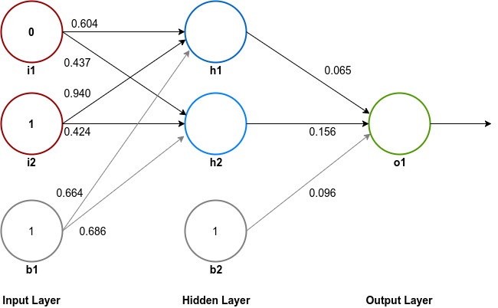
NN
Activation Function = 1/(1+e^{-x})
Weights = strengths of rel. = slope of sigmoid
Bias = control on when to activate
Goal: find min of cost(X)
→ gradient(cost(X)) = 0
^^Intractable → Backpropagation in Gradient Descent Algorithm
https://www.surenderthakran.com/images/articles/tech/implement-back-propagation-neural-network/xor-neural-network-weights.png
Notes:
Let’s see now how these algorithms work.
The 3 proposed techniques are all types of neural networks. What is a neural network then.
You can imagine it as a graph - so made of nodes and arches - which are organised in layers
The first layer of nodes takes all the user input. These nodes either do get activated or not, based on the input. If they do activate, then they forward the user input they had received, modified according to the weight and bias that they had received as well. Otherwise, if not activated, they will forward nothing.
Usually the activation is the sigmoid function f(x) = 1/(1+e^-x). The weight received determines the slope of the sigmoid while via bias we can control when to activate (for instance whenever f(x) is greater than 0, etc.
The final output layer is the classification result. Therefore, if there are 9 classes like in our case, then there will be a vector of 9 elements equal to 0 or 1 whether the original input network traffic packet belongs to that class or not.
The overall goal is to minimise the cost function as much as possible - meaning that the goal is to find the combination of weights and biases such as the difference between the final classification obtained and the expected one, is minimal. If we considered the cost function as a curve, its minimum point is the point at which the derivative is zero. Since we’re talking about matrices, then rather than derivative we say we want the gradient to be 0. How to find this combination is an intractable problem. The best way we nowadays solve it is by backpropagating a small increase or decrease to weights and biases, step-by-step, in what is called gradient descent algorithm. This allows to get closer to the gradient of 0, at each step.

Slide 12
CNN
Convolution = moving filter
x₁
x₂
x₅
x₆
Overlapping area = stride[1, 1]
x₃
x₄
x₇
x₈
Sparse connections
Constant Weights in Filter
Less # Params
Filter → Features → Channel
Non-Linear Activation Function = Rectified Linear Unit (ReLU)
Max() Pooling on sliding window, stride [2, 2]
Batch Normalisation
Loss Function: Softmax Cross Entropy
Flatten m chans of X x Y pooling matrices into vector[X x Y x m]
Notes:
We first apply a convolutional neural network which is a specific type of nn based on convolutions.
Convolution is the name given to a filter that moves across an image.
At each convolutional stage the filter moves horizontally and vertically of a defined amount of steps, called stride.
At each stage, we need multiple filters to train recognising multiple features. Each will produce its own output, which corresponds to what we call “channel”
2 main features characterise CNN: not every input node is connected to an output; and the fact that the weights in each filter are constant. Filters are trained to recognise certain features (feature mapping)
The output is then passed through a Non-Linear Activation Function called Rectified Linear Unit (ReLU).
Then a Pooling step is applied by calculating the max() function, in order to reduce the amount of samples to output to the next layer.
We then repeat several stages of convolutions, ReLU and subsampling. The final layer is fully connected, made of m channels of X x Y pooling matrices. But we want to know whether a given packet belongs to any of the malicious behaviour classes. Therefore, we need to flatten it into a vector of [X x Y x m] elements

Slide 13
LSTM
h_{t-1}
h_{t}
A₁
Time
A₂
h_{t-1}
x_{t-1}
x_{t}
Generic RNN
Notes:
LSTM are a type of RNN (recurrent nn) which we are going to use here and which aim at solving the vanishing gradient problem.
RNNs problem
All RNN are characterised by a cell unit which inherits the relevant information from the previous-in-time cell units. In this way, RNN addresses the issue of utilising the reasoning about previous events in order to inform later ones. In the usual RNN the output from the cell A1 is fed into the new cell A2 as weight and bias, through time. However, RNNs are not able to learn dependencies that are very distant from each other.
LSTMs how they solve RNN problem
LSTM is a specific type of RNN which is instead able to learn this type of dependencies.
An LSTM cell takes an input and stores it for some period of time. This is equivalent to applying the identity function ( f ( x ) = x ) to the input. Because the derivative of the identity function is constant, when an LSTM network is trained with backpropagation through time, the gradient does not vanish.
LSTMs help preserve the error that can be backpropagated through time and layers. By maintaining a more constant error, LSTMs allow recurrent nets to continue to learn over many time steps (over 1000), thereby opening a channel to link causes and effects remotely.
LSTMs how they work
LSTMs contain information outside the normal flow of the recurrent network in a gated cell. Information can be stored in, written to, or read from a cell
the cells learn when to allow data to enter, leave or be deleted through the iterative process of making guesses, backpropagating error, and adjusting weights via gradient descent.
The cell unit contains 3 different types of gates which function like switches. the forget gate represented by sigma here on the slide, filters out which information to retain and which to discard, taking as input the user input x_t and the output from the previous cell h_t-1. It then outputs a number between 0 and 1 which means that x_t should or not be discarded, with varying degrees of confidence. The input and output gate instead, filter what to let in and out , respectively.
In more details, each gate calculates the formulas displayed on the slide, where c_t is the cell state vector, h_t is the output vector and U is the matrix of recurrent connections. W and b are weights and bias. What can be relevant to note here, is the plus sign which sums up - rather than multiplying - the current state with the new input. This is what allows to keep the error constant during backpropagation.
However, before LSTM can process the results we obtained from CNN, we need to reshape that output.
We keep the dim associated with the filter’s action unchanged, while we flatten the other 2 dimensions. The flattened vector will be the time dimension needed by LSTM

Slide 14


Vanishing Gradient Problem
x * y = z; y > 1; z >> 1
Truncate/Squash
x * y = z; y < 1; z << 1
? → LSTM!
Gambler wins 97 cents on every dollar → bankrupt!
Notes:
As a next step we would like to correlate packets that are distant in time. Recurrent NN do that but they are affected by a problem called the Vanishing Gradient. Because it is very difficult to know in advance, how much importance to assign to inputs that are remote in time, then we do not know which direction to follow during the gradient descent, in order to reach the minimum of the error. This is partially because the information flowing through neural nets passes through many stages of multiplication.
Everyone who has studied compound interest knows that any quantity multiplied frequently by an amount slightly greater than one can become immeasurably large (indeed, that simple mathematical truth underpins network effects and inevitable social inequalities). But its inverse, multiplying by a quantity less than one, is also true. Gamblers go bankrupt fast when they win just 97 cents on every dollar they put in the slots.
Because the layers and time steps of deep neural networks relate to each other through multiplication, derivatives are susceptible to vanishing or exploding.
Exploding gradients treat every weight as though it were the proverbial butterfly whose flapping wings cause a distant hurricane. Those weights’ gradients become saturated on the high end; i.e. they are presumed to be too powerful. But exploding gradients can be solved relatively easily, because they can be truncated or squashed. Vanishing gradients can become too small for computers to work with or for networks to learn. Vanishing gradients is then a harder problem to solve than the exploding gradients problem.

Slide 15
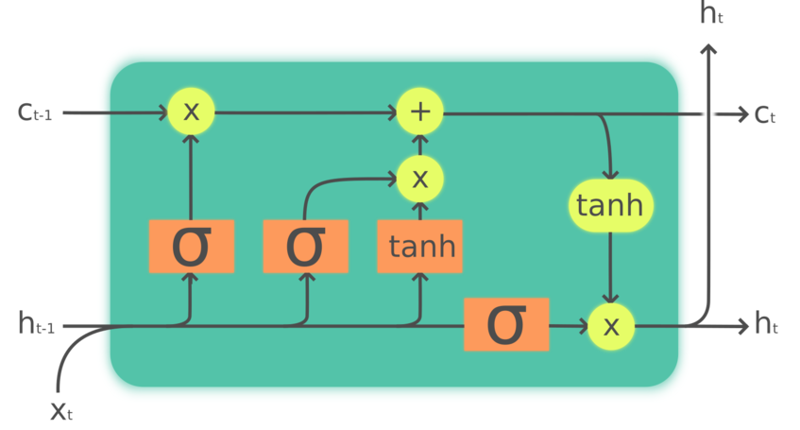
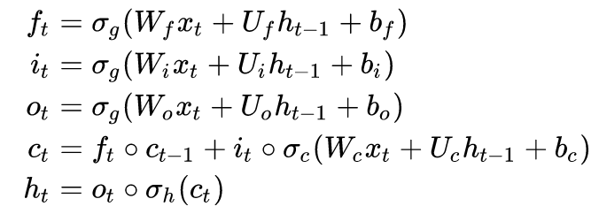
LSTM
h_{t-1}
h_{t}
A₁
Time
A₂
h_{t-1}
x_{t-1}
x_{t}
Generic RNN
LSTM Cell Unit
Forget gate
Input gate
Output gate
(x_{t}, h_{t-1})
Notes:
LSTM are a type of RNN (recurrent nn) which we are going to use here and which aim at solving the vanishing gradient problem.
RNNs problem
All RNN are characterised by a cell unit which inherits the relevant information from the previous-in-time cell units. In this way, RNN addresses the issue of utilising the reasoning about previous events in order to inform later ones. In the usual RNN the output from the cell A1 is fed into the new cell A2 as weight and bias, through time. However, RNNs are not able to learn dependencies that are very distant from each other.
LSTMs how they solve RNN problem
LSTM is a specific type of RNN which is instead able to learn this type of dependencies.
An LSTM cell takes an input and stores it for some period of time. This is equivalent to applying the identity function ( f ( x ) = x ) to the input. Because the derivative of the identity function is constant, when an LSTM network is trained with backpropagation through time, the gradient does not vanish.
LSTMs help preserve the error that can be backpropagated through time and layers. By maintaining a more constant error, LSTMs allow recurrent nets to continue to learn over many time steps (over 1000), thereby opening a channel to link causes and effects remotely.
LSTMs how they work
LSTMs contain information outside the normal flow of the recurrent network in a gated cell. Information can be stored in, written to, or read from a cell
the cells learn when to allow data to enter, leave or be deleted through the iterative process of making guesses, backpropagating error, and adjusting weights via gradient descent.
The cell unit contains 3 different types of gates which function like switches. the forget gate represented by sigma here on the slide, filters out which information to retain and which to discard, taking as input the user input x_t and the output from the previous cell h_t-1. It then outputs a number between 0 and 1 which means that x_t should or not be discarded, with varying degrees of confidence. The input and output gate instead, filter what to let in and out , respectively.
In more details, each gate calculates the formulas displayed on the slide, where c_t is the cell state vector, h_t is the output vector and U is the matrix of recurrent connections. W and b are weights and bias. What can be relevant to note here, is the plus sign which sums up - rather than multiplying - the current state with the new input. This is what allows to keep the error constant during backpropagation.
However, before LSTM can process the results we obtained from CNN, we need to reshape that output.
We keep the dim associated with the filter’s action unchanged, while we flatten the other 2 dimensions. The flattened vector will be the time dimension needed by LSTM

Slide 16
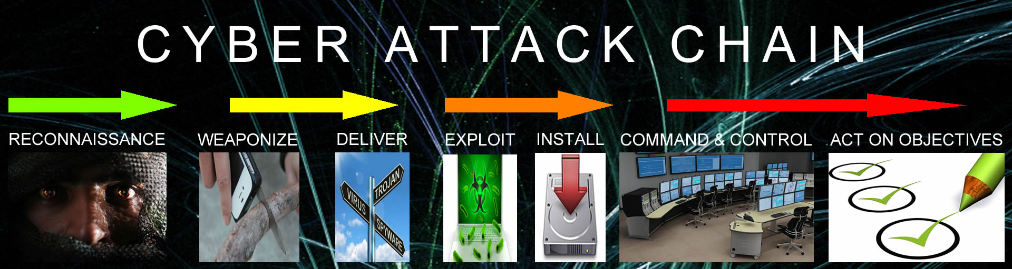
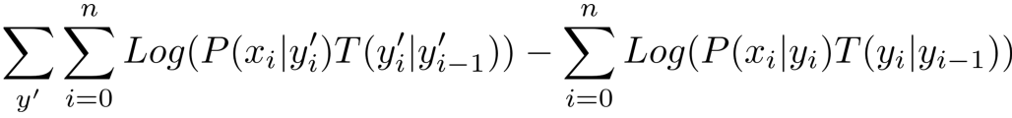
CRF
Interdependence of attackers’ movements
Given X sets of packets, Y labels,
Goal: find transition matrix T that minimises the neg log likelihood
(avg-ed for the whole dataset → HUGE denominator
BUT current label only depends on previous label
aka
Forward-Backward Algorithm
2) Goal: use T to find the most likely seq of labels, given a seq of packets
aka
Viterbi Algorithm
Notes:
As an attacker, the probability that I will ssh into a host only after I have ssh-ed and privilege-escalated another host, is high if the two hosts are able to communicate with each other
This is an example in which previous attackers’ behaviours affect what the attackers’ future movements will be. In this case, it is important to take the interdependence of the attackers’ movements into account in order to be successful.
This is where Conditional Random Fields or CRF come into play.
Given a set of packets X and a set of labels Y, CRF first finds the transition matrix T such that it minimises the negative logarithmic likelihood and then it uses this matrix in order to find the most likely sequence of labels given a set of packets.

Slide 17
Promising Results
Notes:
This proposed technique is quite promising and disruptive. It would solve the problem of analysing encrypting traffic without decrypting it. Decrypting traffic presents a security issue as explained, but also performance issue, since the process of decrypting and re-encrypting content is costly in terms of time and resources

Slide 18

Promising Results
Learning (car) Traffic as Images (2017)
Goal: network speed prediction
CNN || RNN || LSTM
CNN performs best in long-term predictions
CNN outperforms with +42.91% on avg acc
Network Traffic Classifier for IoT (2017)
Goal: infer the application/service used
CNN + LSTM
2 CNN layers + 1 LSTM outperforms with 96% accuracy
Implementation in progress
Notes:
The full implementation is still a work in progress. However, previous work from 2017 which applied CNN and LSTM to car traffic and network traffic, presented promisnig results up to 96% accuracy, on which we believe we can improve thanks to our specific data preprocessing and additional Conditional random fields step.

Slide 19

Future Work
Bidirectional LSTM (having access to future packets for a given range of time)
ELU may be better as an activation function than ReLU
Try changing in CNN:
loss function,
hyperparameters for convolutional and pooling layers (filter size, pooling size, polling method),
depth of the CNN
Identify which packets’ metadata are more relevant for classification
Include the encrypted payload among the considered features
Notes:
There is a lot of possible variations on what we’re proposing here. Besides varying the algorithm parameters and perhaps utilising different activation functions or the bidirectional LSTM, another possibility is to include the encrypted payload in the analysis, as one of the features. That’s because deep learning techniques applied to obfuscated malware, have achieved a good malware detection rate, in recent years.
I hope all these ideas will inspire you to do the same - setting up your own environment is very easy using Amazon-provided services:
* you can choose the tensorflow cx solution
* set up aws ec2 with gpu support (choosing an AMI with at least 1 NVIDIA GPU)
and that’s it.

Slide 20

@iammyr
Notes:
Thank you for your attention and happy hacking to everyone!

